Slide 1
DAR ES SALAAM INSTITUTE OF TECHNOLOGY
DEPARTMENT OF COMPUTER STUDIES
BACHELOR OF ENGINEERING IN COMPUTER ENGINERING
PROJECT TITLE: | DEVELOPMENT OF CLOUD-BASED HOTSPOT MANAGEMENT AND BILLING SYSTEM
CASE STUDY: | MARKET AREA (KARUME MARKET)
STUDENT’S NAME: | SHABILU ALLY HAMISI
SUPERVISOR NAME: | MR. NOEL MAGANGA
REGISTRATION NO: | 220242427383
DATE: | 20th may 2026

Slide 2
BACKGROUND OF THE STUDY
Internet access is essential in karume marketplaces for business, communication, and mobile money services.
Hotspot providers may operate multiple routers in different areas, but most routers are managed separately.
Lack of centralized multi-router management makes it hard to monitor router availability, connected users and payments.
Manual billing through cash, vouchers, or manual mobile money confirmation causes delays, errors, and poor revenue tracking.
This project developed a cloud-based multi-router hotspot management and billing system for centralized router monitoring, captive portal access, automated billing, alerts, and reporting.

Slide 3
PROBLEM STATEMENT
Marketplace hotspot services are often unreliable and difficult to monitor.
Manual billing causes payment delays, errors, and poor revenue tracking.
Hotspot routers are managed separately, making multi-router control difficult.
Shared passwords and manual access control reduce security.
Service expansion is difficult without centralized management.
A cloud-based system is needed to manage users, billing, routers, alerts, and reports efficiently.
Notes:
Bullet way

Slide 4
MAIN OBJECTIVE
To Develop a cloud-based hotspot billing and management system.

Slide 5
SPECIFIC OBJECTIVE
To implement a captive portal billing module integrated with mobile money payment platforms.
To design a cloud-based architecture for centralized management of multiple Wi-Fi hotspot routers.
To implement a router monitoring module for reporting router availability to the cloud server.

Slide 6
SIGNIFICANCE OF THE STUDY
Reduces manual work in billing, access control, and router monitoring.
Improves centralized management of multiple hotspot routers and users.
Enables convenient self-service Internet purchase and renewal through mobile money.
Improves service reliability through router availability monitoring.
Supports scalable hotspot deployment across different locations.

Slide 7
SCOPE OF THE PROJECT
Development of a cloud-based hotspot management and billing system.
Centralized management of multiple Wi-Fi hotspot routers.
Captive portal for user authentication, plan selection, and Internet access control.
Billing module with mobile money payment support.
Router monitoring module for reporting router availability.
Reports for users, payments, routers, sessions, and service performance.
Project Limits:
The project does not cover full ISP infrastructure, physical marketplace-wide deployment, advanced ISP-level bandwidth optimization, or full production mobile money API integration during prototype testing.

Slide 8
LITERATURE REVIEW
Summary of Previous Studies
Study | Focus Area | Key Contribution
Wiederkehr (2009) | Hotspot Authentication & Security | - Discussed hotspot login mechanisms - Introduced AAA (Authentication, Authorization, Accounting) framework - Compared captive portal vs 802.1X/EAP security models
Owoh (2024) | Usage-Based Billing Using MikroTik | - Developed system to track user data consumption - Integrated MikroTik RouterOS with backend system - Generated billing reports based on usage

Slide 9
Existing Local Hotspot System
Standalone routers
Shared Wi-Fi passwords
Manual voucher systems
Cash or manual mobile money payments
No centralized monitoring

Slide 10
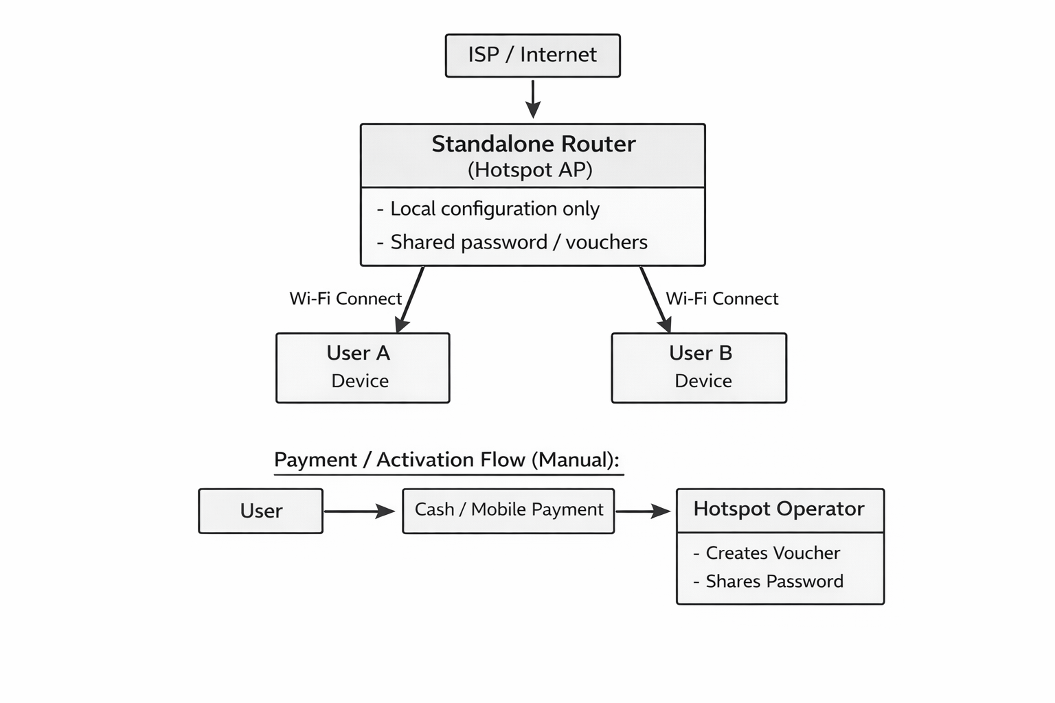
BLOCK DIAGRAM OF EXISTING SYSTEM

Slide 11
Problems in Existing System
Weak security
No centralized control
Manual payment verification
Poor scalability
No real-time monitoring

Slide 12
PROPOSED CLOUD-BASED SYSTEM
Cloud-based authentication
Automated billing system
Mobile money integration
Router monitoring module
Multi-location management

Slide 13
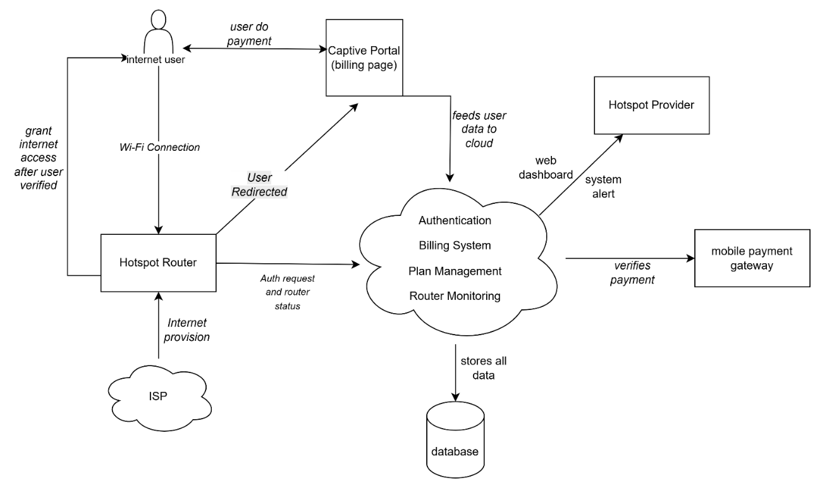
BLOCK DIAGRAM OF PROPOSED SYSTEM

Slide 14
METHODOLOGY
This project used the Prototyping Model for system development.
Data was collected using primary and secondary data collection methods.
Primary data was collected through a closed-ended questionnaire.
Secondary data was collected through review of books, journals, previous studies, project reports, and technical documentation.
System development involved requirement analysis, system design, prototype development, testing, and refinement.
The final deliverables included a cloud-based admin dashboard, captive portal billing module, router monitoring module, and system reports.

Slide 15
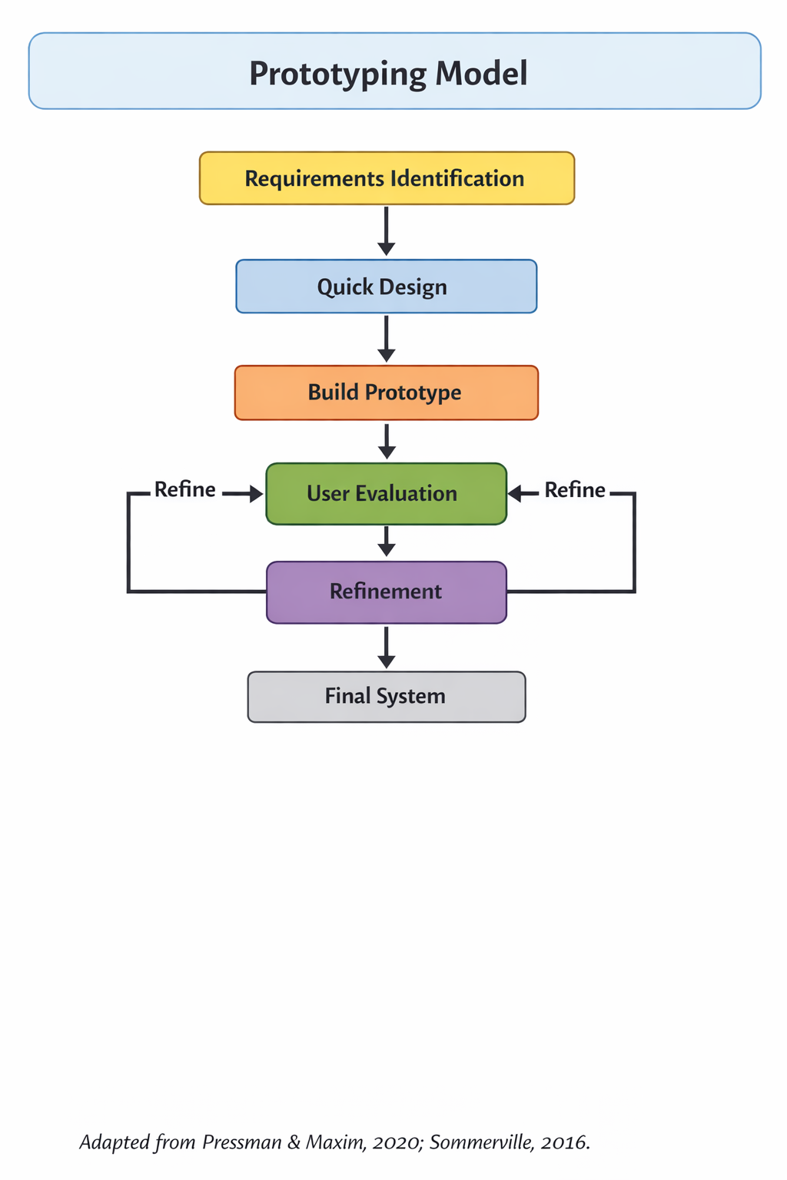
Prototyping Model Overview

Slide 16
SYSTEM DEVELOPMENT TOOLS AND TECHNOLOGIES
React / Vite — used to develop the captive portal and admin dashboard.
Spring Boot — used to develop the backend system logic.
PostgreSQL — used to store users, routers, payments, plans, and sessions.
OpenWrt / openNDS — used for hotspot router testing and captive portal redirection.
REST API — used for communication between frontend, backend, router, and payment module.
GNS3 / VirtualBox — used to simulate and test the network environment.
Draw.io — used to design system diagrams.

Slide 17
PRIMARY DATA COLLECTION METHOD
Collected directly from respondents in marketplaces like Karume Market.
Structured closed-ended questionnaire (Yes/No, multiple choice, rating scales).
Respondents: Wi-Fi providers/hotspot operators, and Internet users.
Topics that focused:
Hotspot management practices
Billing/payment methods
Authentication mechanisms
Bandwidth and network monitoring challenges
User satisfaction

Slide 18
Secondary Data Collection
Uses existing research, reports, and technical documentation.
To understand cloud architecture, centralized management, and client-server communication from cloud computing and computer networking books. Online
To study hotspot authentication, captive portal access, billing mechanisms, and user access control from academic journals and research papers. Like. Wiederkehr (2009); Saliu et al. (2013)
To identify gaps in multi-router management, mobile money payment, and router monitoring from previous Internet billing project reports. Example: Owoh (2024)
To guide hotspot router configuration, captive portal redirection, and router-server communication using technical documentation. Examples: MikroTik Documentation; OpenWrt Documentation; openNDS Documentation

Slide 19
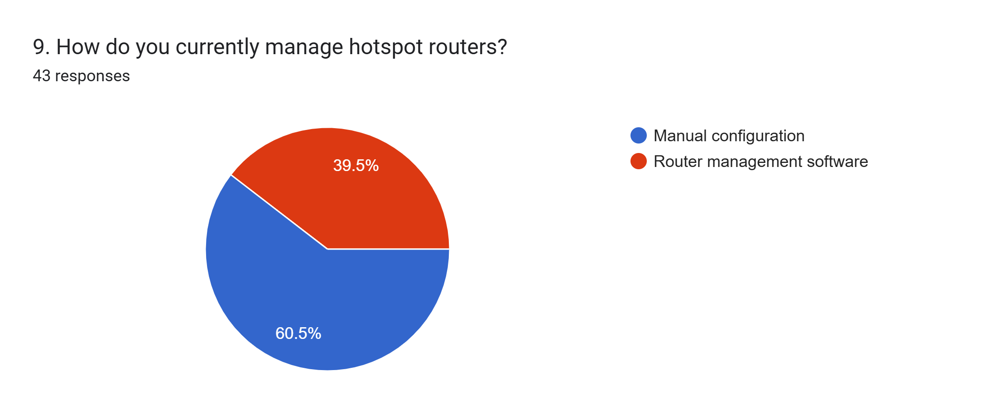
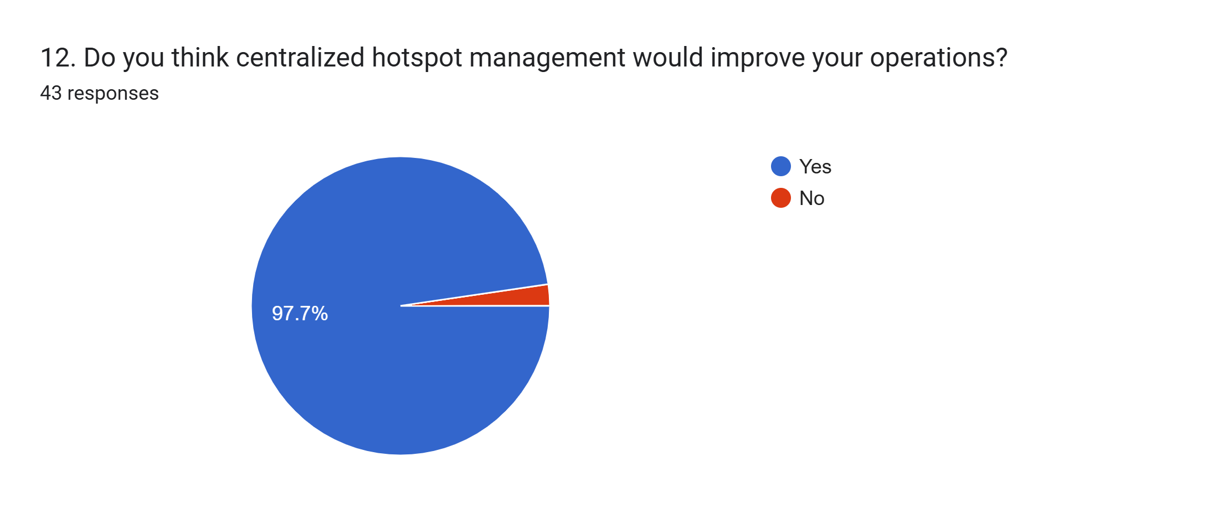
DATA ANALYSIS
CENTRALIZED MULTI-ROUTER MANAGEMENT

Slide 20
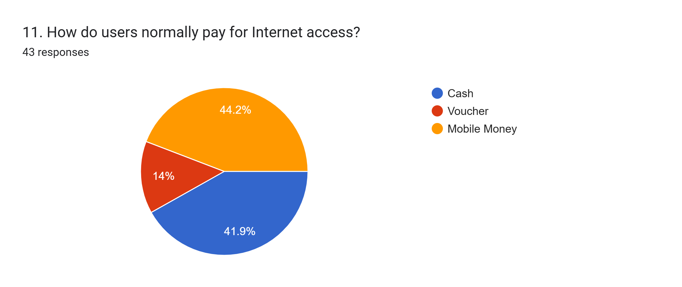
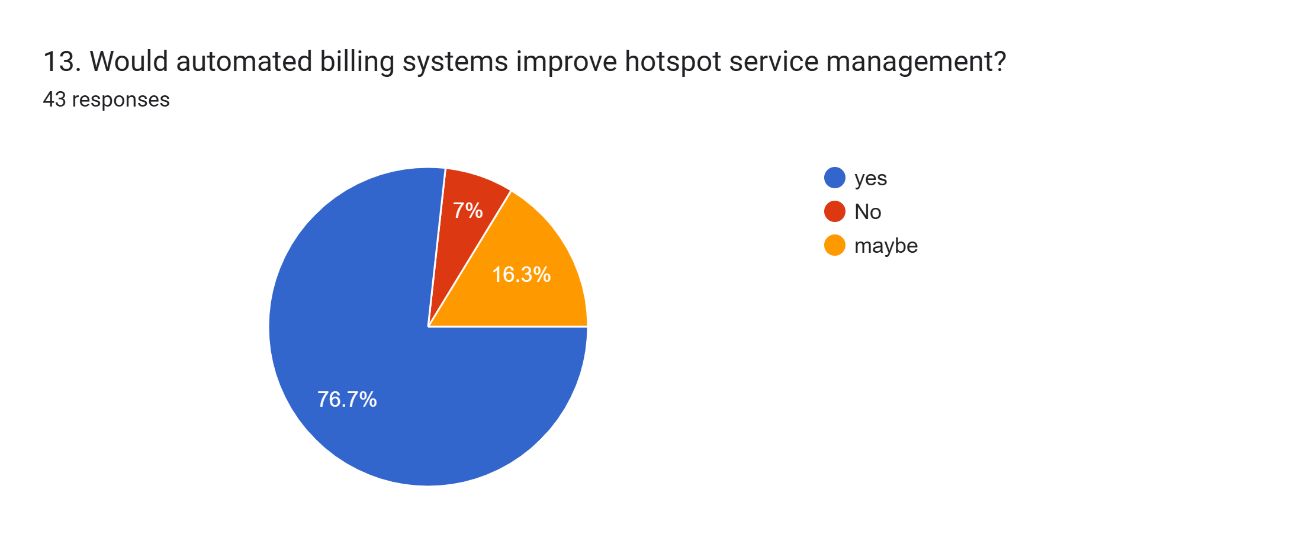
DATA ANALYSIS
CAPTIVE PORTAL AND BILLING

Slide 21
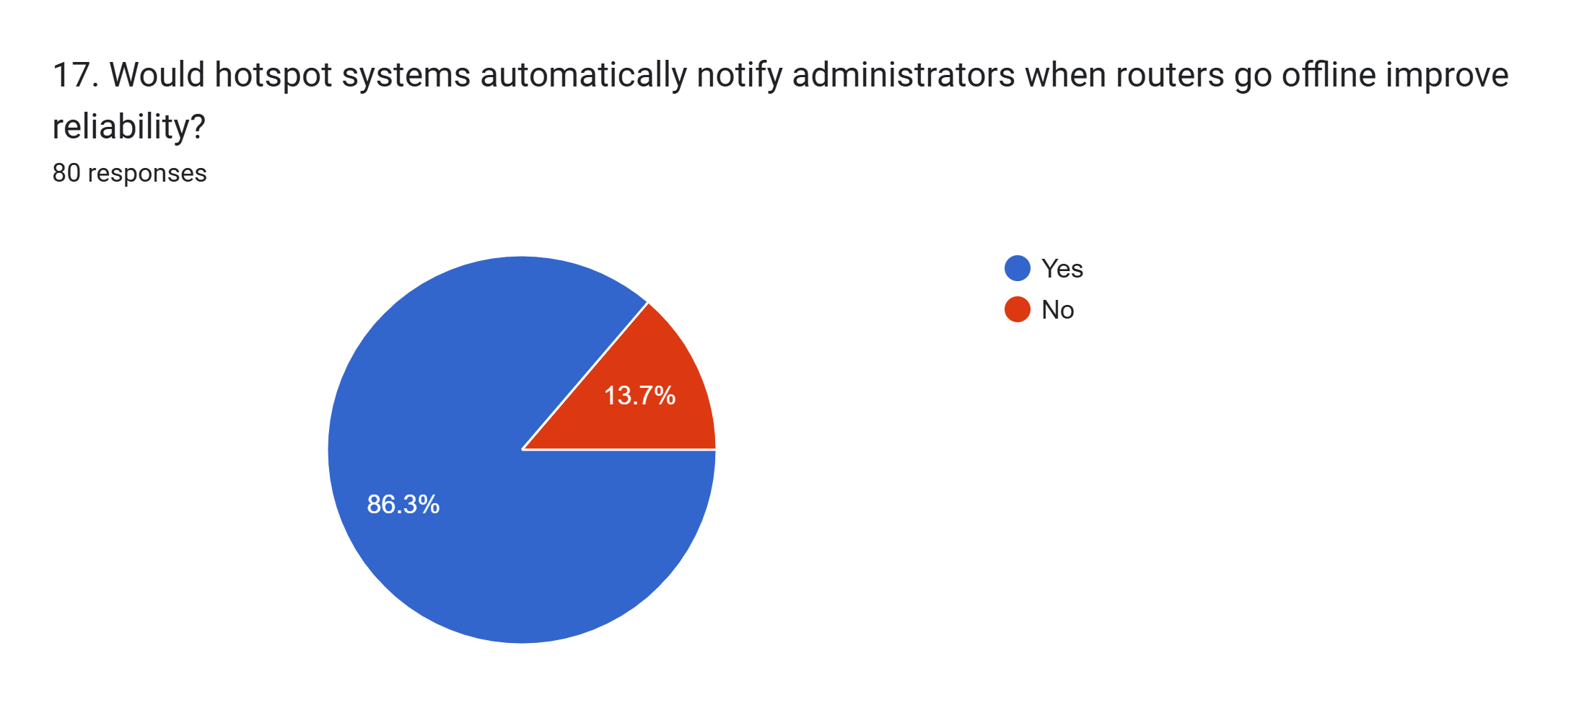
DATA ANALYSIS
ROUTER MONITORING

Slide 22
DATA ANALYSIS
Functional Requirements
User connects to Wi-Fi and opens captive portal.
User selects Internet plan.
User pays through mobile money.
System activates Internet access after payment.
Admin manages routers, users, plans, payments, and reports.
Router sends online/offline status to cloud server.
Non-Functional Requirements
Easy to use
Secure login and payment records
Fast response time
Reliable router monitoring
Scalable for many routers
Available through cloud access

Slide 23
Main Modules
Captive Portal Module
Billing Module
Payment Module
Router Management Module
Router Monitoring Module
Admin Dashboard
Reports Module

Slide 24
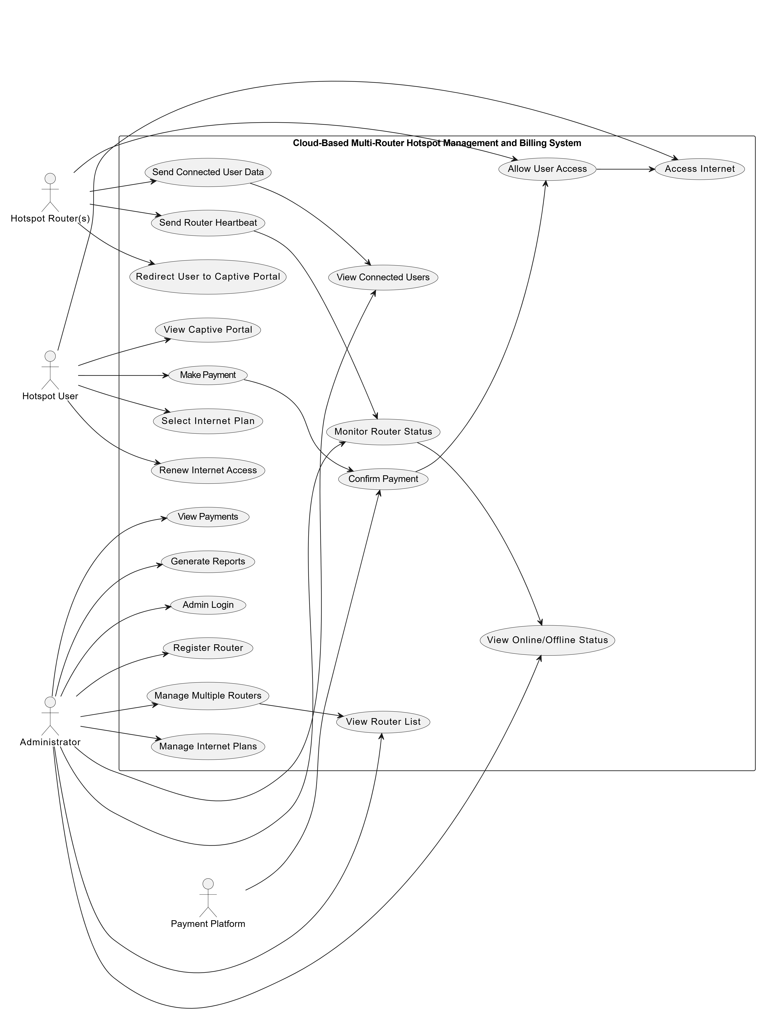
USE CASE DIAGRAM

Slide 25
USE CASE DIAGRAM
Actors
Hotspot User
Administrator
Hotspot Router(s)
Payment Platform
Main Use Cases
Hotspot User
View Captive Portal
Select Internet Plan
Make Payment
Access Internet
Renew Internet Access
Administrator
Admin Login
Register Router
Manage Multiple Routers
View Router List
Monitor Router Status
View Online/Offline Status
View Connected Users
Manage Internet Plans
View Payments
Generate Reports
Hotspot Router(s)
Redirect User to Captive Portal
Send Router Heartbeat
Send Connected User Data
Allow User Access
Payment Platform
Confirm Payment

Slide 26


THANK YOU

